Slide 1
Design and Control of the BlueFoot Platform:
A Multi-terrain Quadruped Robot
Brian Cairl
Dr. Farshad Khorrami
May 13, 2015

Slide 2
Overview
Introduction
Hardware and Design
Software Architecture
BlueFoot: Kinematic and Dynamical Modeling
Gait and Stability Control
Navigation Control
Concluding Remarks

Slide 3
Introduction

Slide 4
Quadruped Robotics
Inspired by notable quadruped robotic systems from the past decade:
LittleDog (Boston Dynamics)
BigDog (Boston Dynamics)
Tekken (Kyoto Institute of Technology)
Kolt (Stanford University)
HyQ (Istituto Italiano di Tecnologia)

Slide 5
Quadruped Robotics, cont.
Well known advantages over wheeled robots, mainly in adaptability to terrain
At the follows expenses:
Higher power consumption (more actuators)
Lower payload capacity (higher actuator loading)

Slide 6
Quadruped Robotics, cont.
Applications:
Gaiting design/research
Rough-terrain navigation/planning
Disaster recovery
Search and rescue
Environmental mapping

Slide 7
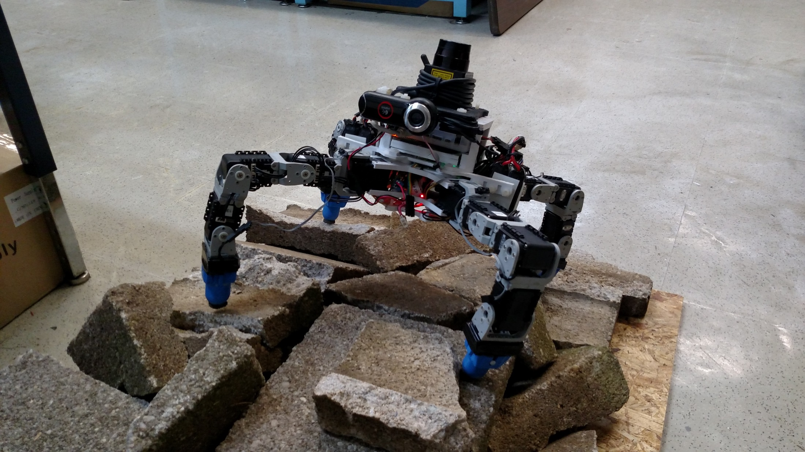
The BlueFoot Platform

Slide 8
The BlueFoot Platform, cont.
Small-scale quadruped robot
16 actuated degrees of freedom
Multi-processor/distributed control implementation
High Dexterity, which lends itself to:
Stabilization and repositioning on variable terrain
Large range of trunk articulation
Ability to overcome raised/uneven terrain

Slide 9
Overview of Control Strategies
Gaiting and Stability
Central Pattern Generator (CPG)-based gait control
Zero-Moment Point (ZMP) body posture control
Virtual-Force foothold controller
NARX-Neural Network trunk-leveling controller

Slide 10
Overview of Control Strategies, cont.
Navigation Control:
Potential-Fields/Visual-Servoing
Surface Reconstruction for rough terrain navigation
Composing 3D point clouds from 2D LIDAR scans
Height-map Surface Representation
Surface (Normal) Estimation from 3D point clouds
Rough terrain planning using Height-maps

Slide 11
System Design

Slide 12
Design Overview
Modularity between body segments
Robot designed with 3 main sections
3D printed structural components
Lightweight
Rapid design iterations
Facilitates modular design

Slide 13
Core Devices
AutoPilot (IMU, pressure sensor, humidity/temperature sensor)
ODROID-XU computer
Logitech9000 Web Camera
Hokuyo-URG LIDAR
Dynamixel AX12 Smart Servos (x16)
Binary foot-contact sensors
XBEE Wireless Radio
GPS

Slide 14
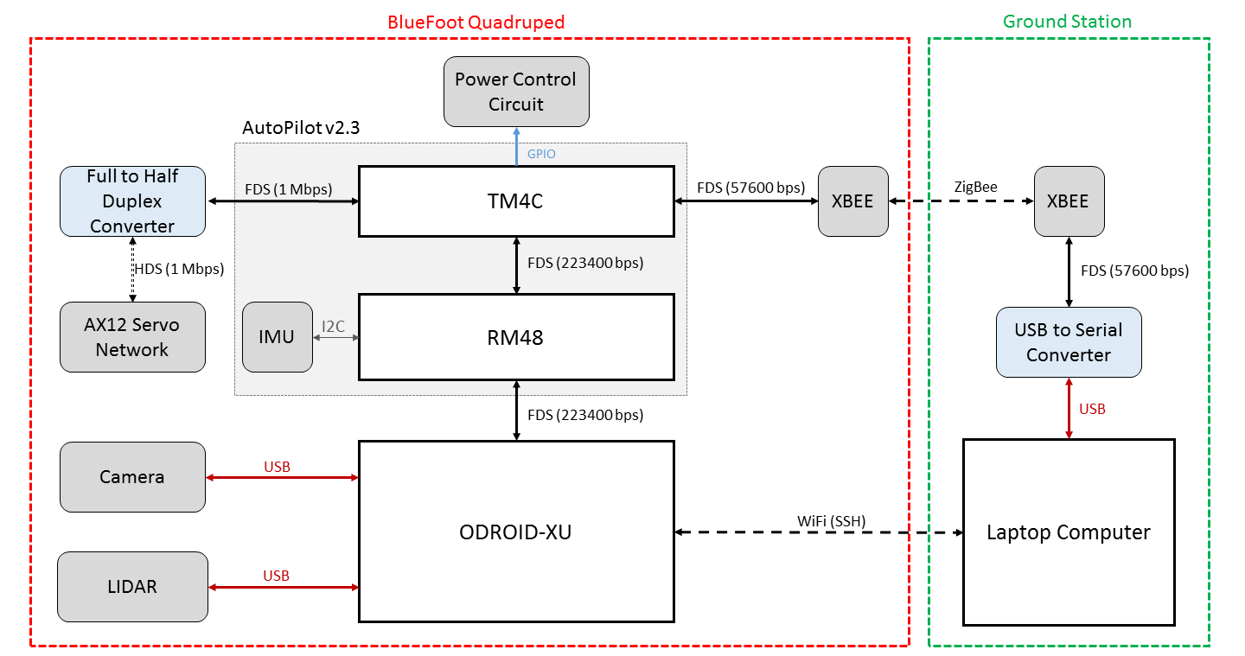
Device Interfacing

Slide 15
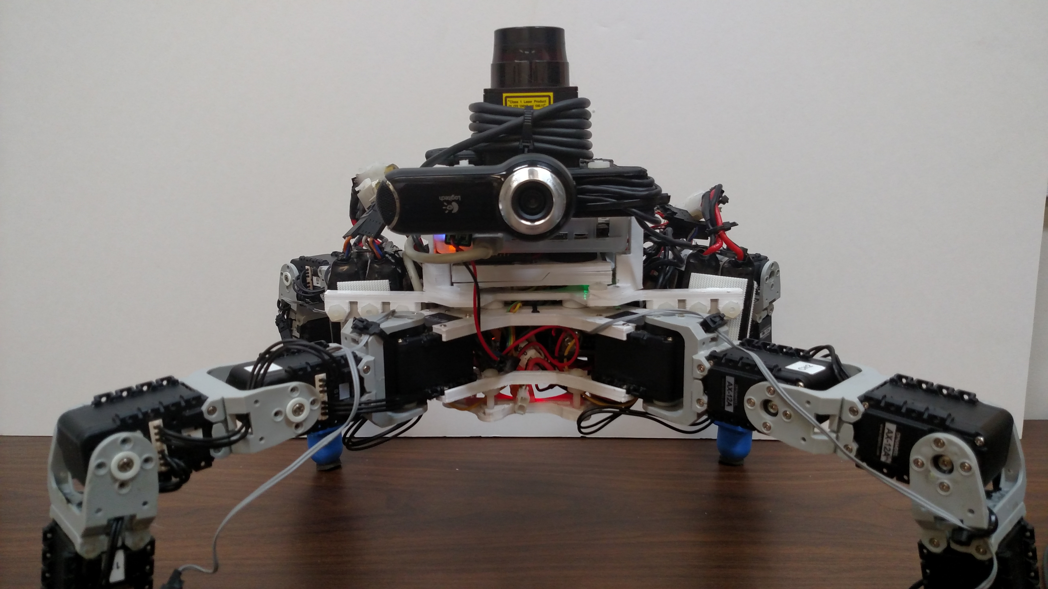
Structural Layout
Head Module
Main Module
Root Module
Legs

Slide 16
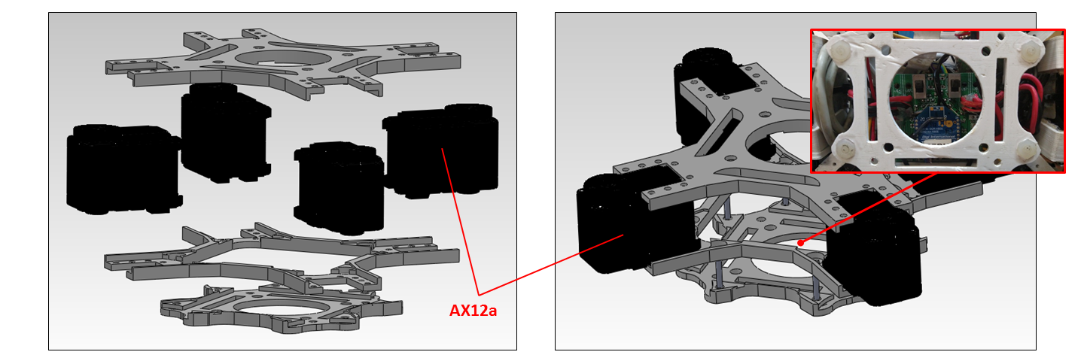
Lower Body (Root Module)

Slide 17
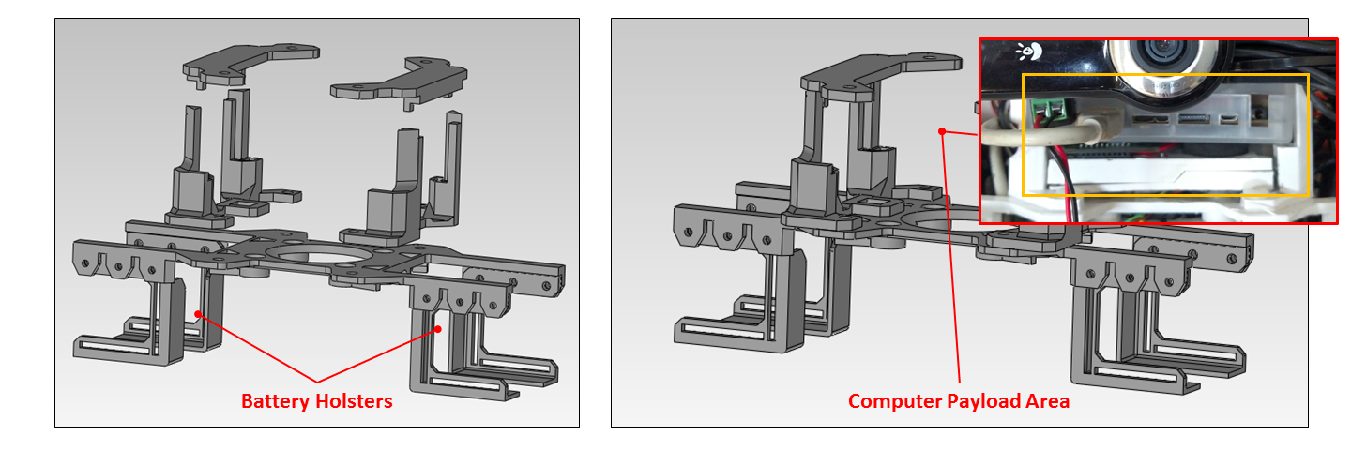
Mid Body (Main Module)

Slide 18
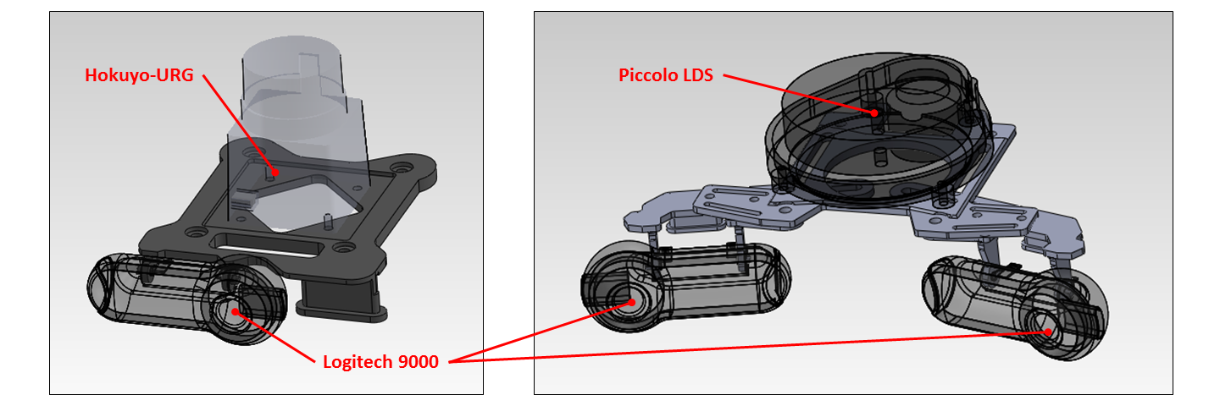
Upper Body (Head Module)

Slide 19
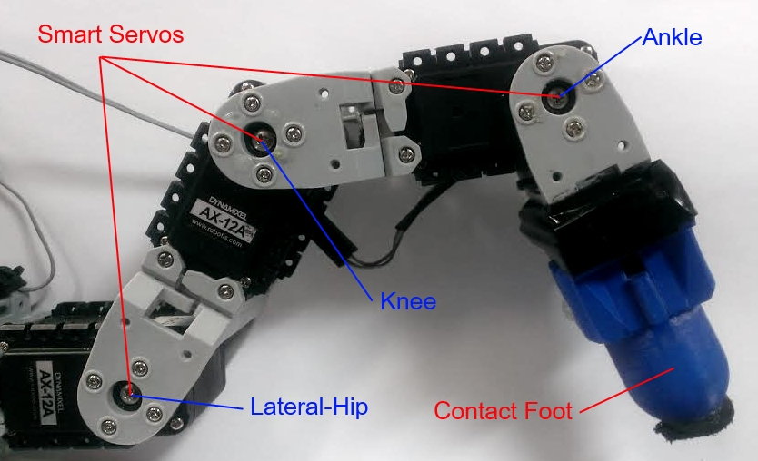
Leg Design

Slide 20
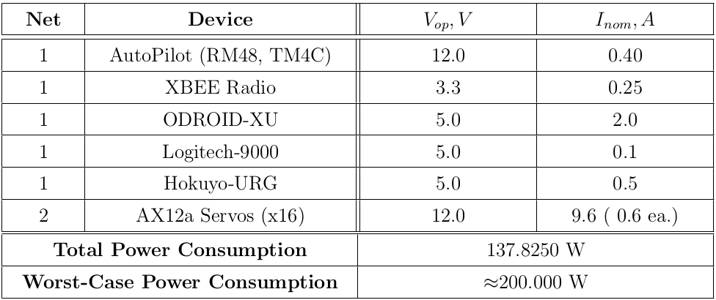
Power Requirements

Slide 21
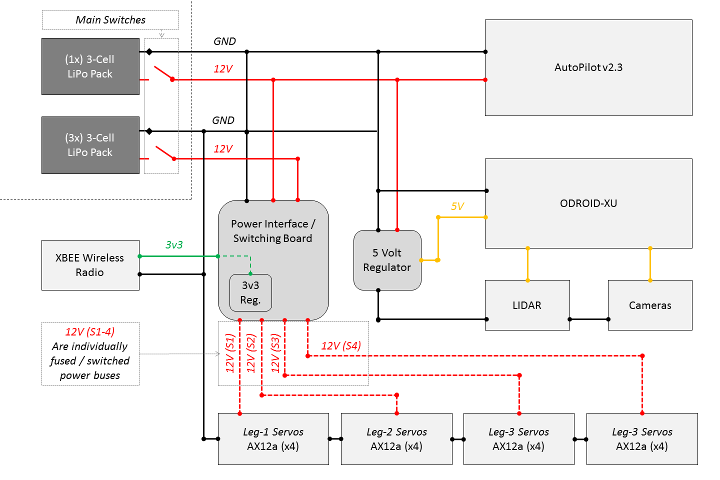

Slide 22
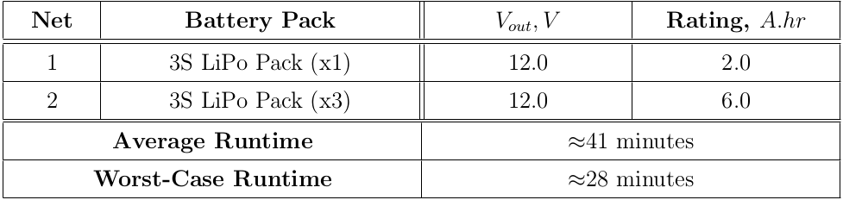
Power Capacity and Run-time

Slide 23
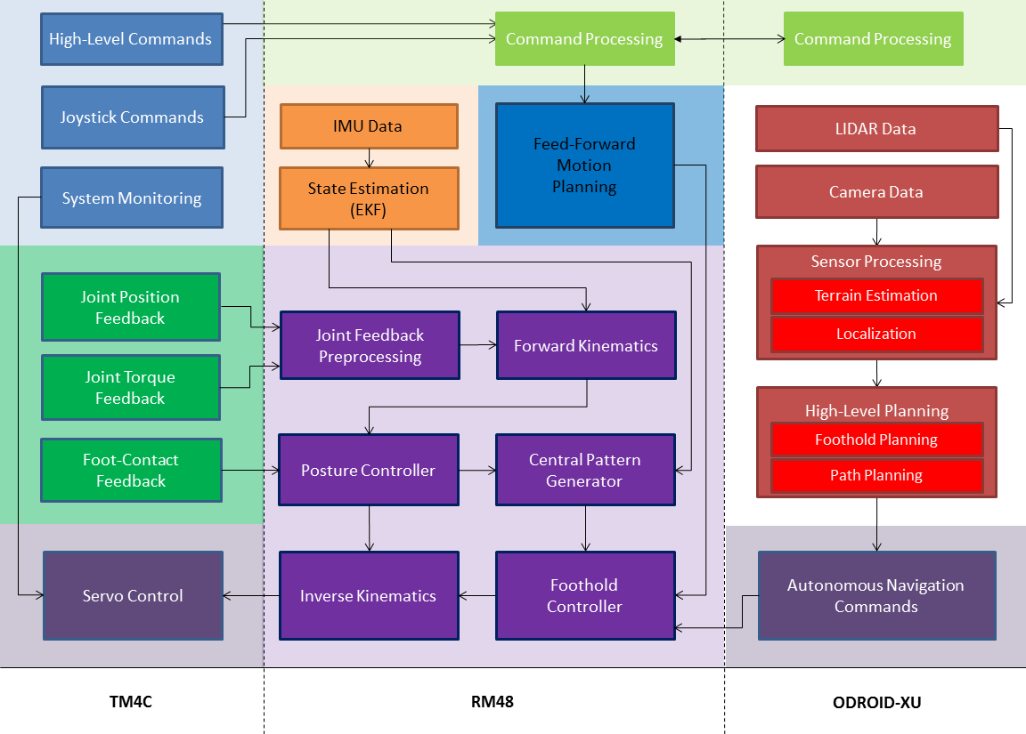
Control Process Outline

Slide 24
Core Devices

Slide 25
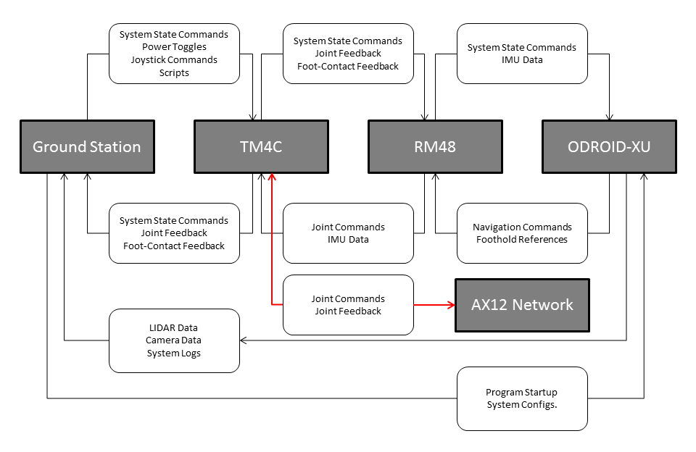

Slide 26
System Modeling

Slide 27
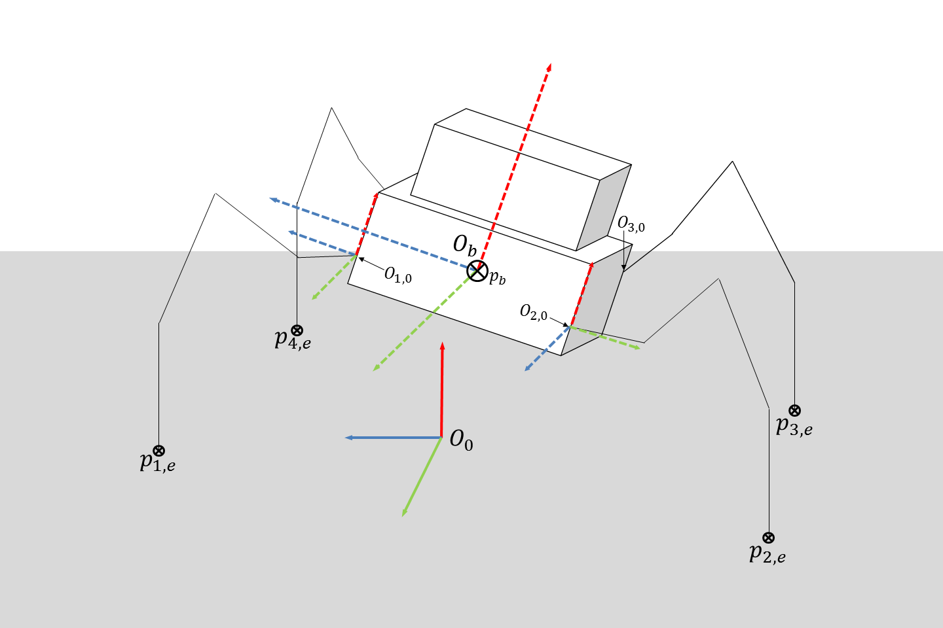
Coordinate Frame setup for Position Kinematics

Slide 28
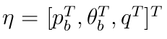
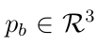
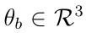
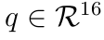
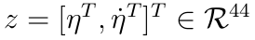
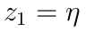
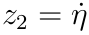
System State Vector
Considering the robot as a free-floating system with 4 legs (each 4DOF):
Trunk Position
Trunk Orientation
Joint angles
Gives rise to the following state vector:

Slide 29
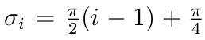
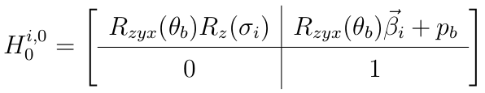
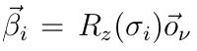
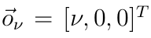
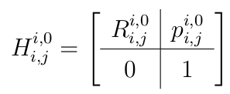
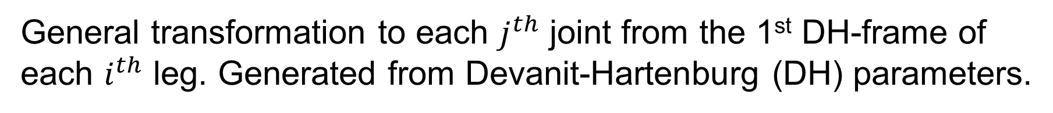
Position Kinematics: Frame Transformations
Position of the first joint of the $i^{th}$ leg in the world frame.
General transformation to each $j^{th}$ joint from the 1st DH-frame of each $i^{th}$ leg. Generated from Devanit-Hartenburg (DH) parameters.

Slide 30
Position Kinematics: Frame Transformations
Position of the first joint of the $i^{th}$ leg in the world frame.
Trunk Orientation
Trunk Position
General transformation to each $j^{th}$ joint from the 1st DH-frame of each $i^{th}$ leg. Generated from Devanit-Hartenburg (DH) parameters.

Slide 31
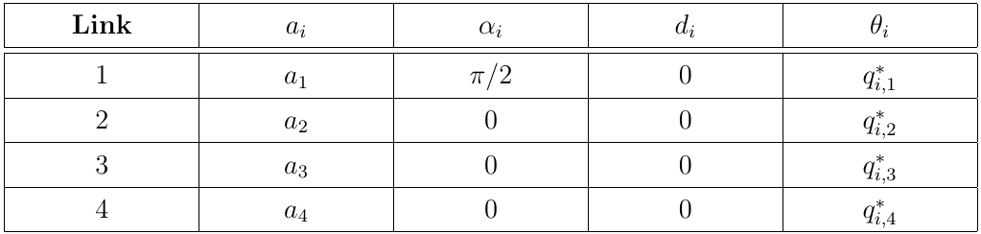
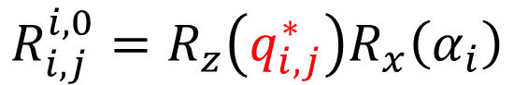
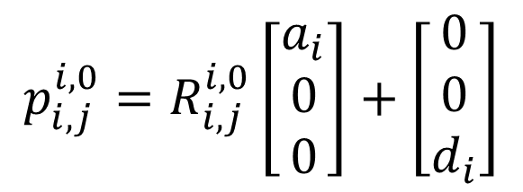
Position Kinematics: DH-Parameters
$$R_{i,j}^{i,0}=R_{z}\left(q_{i,j}^{∗}\right)R_{x}\left(α_{i}\right)$$
$$p_{i,j}^{i,0}=R_{i,j}^{i,0}\left[\begin{aligned}a_{i} \\ 0 \\ 0\end{aligned}\right]+\left[\begin{aligned}0 \\ 0 \\ d_{i}\end{aligned}\right]$$

Slide 32
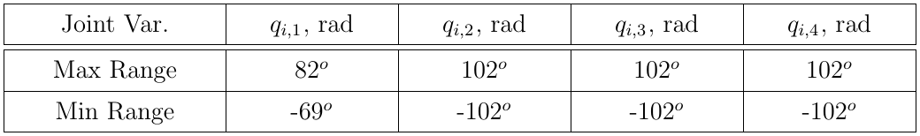
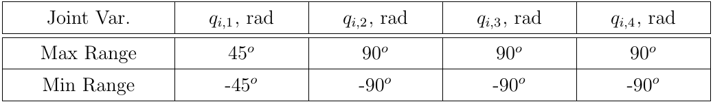
Joint Position Limits
Joint position limits (hardware-constrained)
Joint position limits (software-imposed)

Slide 33
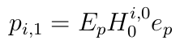
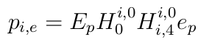
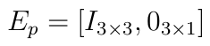
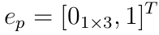
Position Kinematics: Joint/Foot Positions
Position of the first joint of the $i^{th}$ leg in $O_{0}$.
Position of each $j^{th}$ joint of the $i^{th}$ leg in $O_{0}$.
Position of each foot of the $i^{th}$ leg in $O_{0}$.

Slide 34
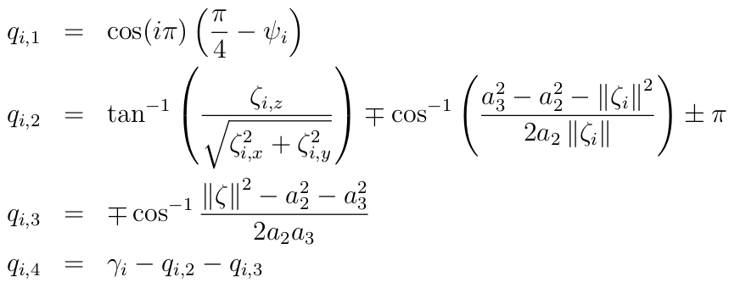
Inverse Position Kinematics (IK)
Joint configuration solution for the $i^{th}$ leg, given $p_{i,e }$and $γ_{i}$:

Slide 35
Inverse Position Kinematics (IK)
Joint configuration solution for the $i^{th}$ leg, given $p_{i,e }$and $γ_{i}$:
Ankle configuration

Slide 36
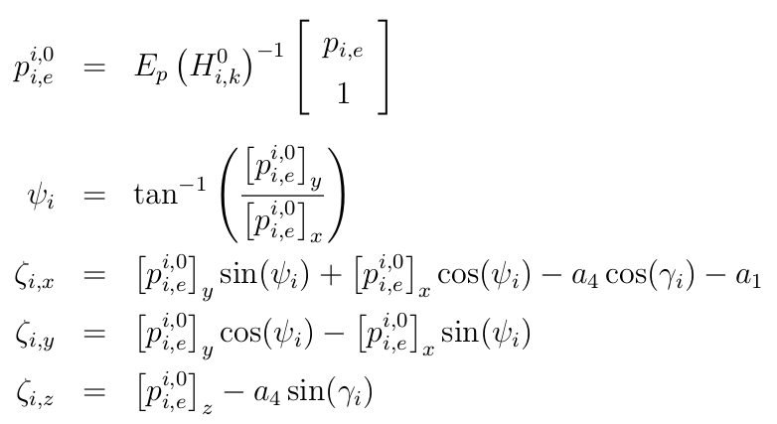
Inverse Position Kinematics, cont.

Slide 37
Inverse Position Kinematics, cont.
Foot position in local frame
Foot position configuration

Slide 38
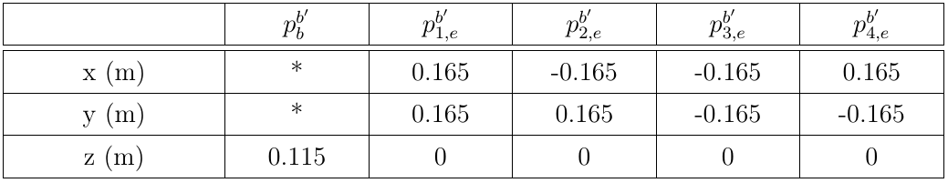
Limits on Body Posing
Kinematic feasibility of each pose is checked using the inverse kinematic solution.
Default robot stance when upright

Slide 39
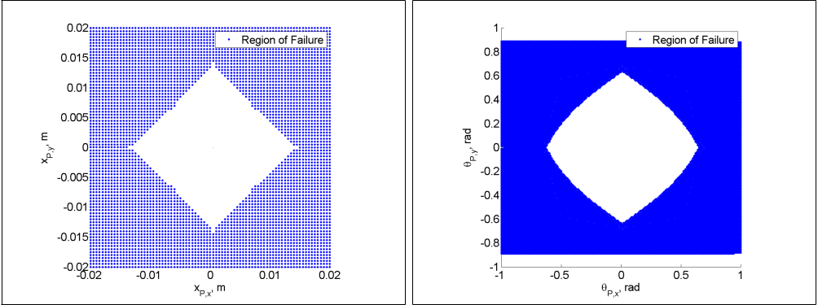
Limits on Body Posing, cont.
Trunk position (x,y)
Orientation (roll and pitch)

Slide 40
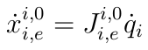
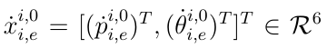
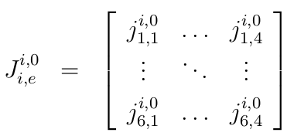
Velocity Kinematics : Manipulator Jacobian
A mapping for foot velocity in each $i^{th}$ local leg frame defined by:
Manipulator Jacobian for the $i^{th}$ leg, given $p_{i,e }$and $γ_{i}$:

Slide 41
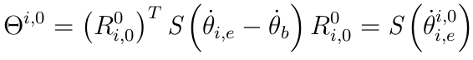
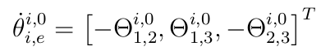
Velocity Kinematics : World Frame Tranformations
Given a body and foot velocities in $O_{0}$:

Slide 42
Velocity Kinematics : World Frame Tranformations
Given a body and foot velocities in $O_{0}$:
Angular rate of foot
Angular rate of body
Foot translational velocity
Trunk translational velocity

Slide 43
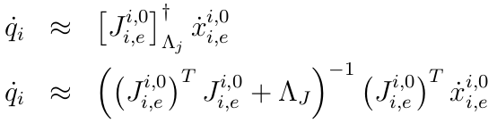
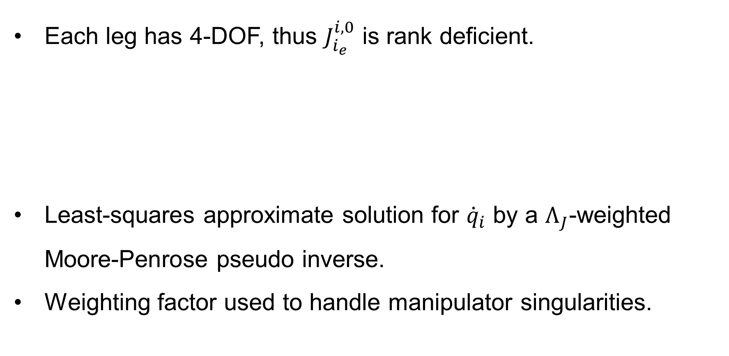
Inverse Velocity Kinematics
Each leg has 4-DOF, thus $J_{i_{e}}^{i,0}$ is rank deficient.
Least-squares approximate solution for ${\dot{q}}_{i}$ by a $Λ_{J}$-weighted Moore-Penrose pseudo inverse.
Weighting factor used to handle manipulator singularities.

Slide 44
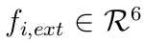
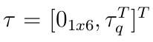
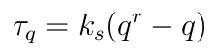
Dynamical Model
Dynamics of the system takes the following form:
with external contact-forces:
and joint input torque dynamics:

Slide 45
Dynamical Model
Dynamics of the system takes the following form:
Lump disturbance term
with external contact-forces:
and input torque dynamics:

Slide 46
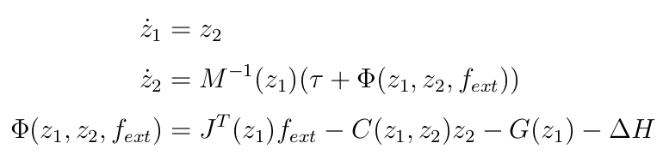



Dynamical Model : State Space Representation
First-order discretization with a sampling period $Δ_{s}$:

Slide 47

BlueFoot Simulator

Slide 48
BlueFoot Simulator, cont.
Full quadruped dynamic requires an analysis of many dynamical modes for each foot contact configuration.
Actual contact dynamics (friction, multiple collisions) can be complex
A numerical dynamical simulator helps reduce complexity
Configurable environments

Slide 49

BlueFoot Simulator, cont.
Implemented using the Open Dynamics Engine C++ library
Generates dynamical updates for all bodies via constrained quadratic minimization
Rigid body and contact dynamics formulated as a Linear Complimentary problem (LCP)
First-order integration with small time-step ($Δt≪1$)

Slide 50


Slide 51
Gaiting and Stabilization

Slide 52
Central Pattern Generator (CPG)-based Gaiting

Slide 53


CPG with Hopf Unit Oscillators
Each $i^{th}$ Hopf oscillator has a state-pair
which make up the CPG network state vectors $y_{1} ,y_{2}∈R^{4}$ by:

Slide 54


CPG with Hopf Unit Oscillators, cont.
The full Hopf-oscillator network dynamics are then
with

Slide 55
CPG with Hopf Unit Oscillators, cont.
The full Hopf-oscillator network dynamics are then
Amplitude
Frequency
Amplitude Modulation Matrix
Frequency Modulation Matrix
Coupling Matrix
with

Slide 56


CPG Network Frequency Matrix
Frequency matrix is adjusted as a function of network outputs, as done by Vitor Matos, et al:
Base frequency adjusted according to command velocities by:

Slide 57

CPG Network Frequency Matrix
Frequency matrix is adjusted as a function of network outputs, as done by Vitor Matos, et al:
Base Frequency
Duty Factor: $\left[0,1\right]$
Base frequency adjusted according to command velocities by:

Slide 58



CPG “Reflex” Design
Reflexes designed using modulation parameters:
$i^{th}$ leg reflexes using inertial feedback:

Slide 59
CPG “Reflex” Design
Reflexes designed using modulation parameters:
$i^{th}$ leg reflexes using inertial feedback:
Sigmoid Activation

Slide 60


Oscillator Coupling Design
Coupling matrix is tuned to produce different phase offsets between oscillators:
Produces 4-Pace Walking Gait
Produces 2-Pace Trotting Gait

Slide 61

Reflexive CPG Outputs during Trotting Gait

Slide 62

Reflexive CPG Outputs during Walking Gait

Slide 63

Reflexive CPG Output during Gait Transition

Slide 64

Foothold Controller

Slide 65





Foothold Controller, cont.
Reference velocity of each foot is defined by:
with

Slide 66
Foothold Controller, cont.
Reference velocity of each foot is defined by:
with
Translation Control
Height Control
Viscous Friction
Attraction Force
Reaction Force

Slide 67


Foothold Controller, cont.
Moving anchor-points for each $i^{th}$ foot and center point, $p_{c}$, are defined with the following dynamics:

Slide 68
Foothold Controller, cont.
Moving anchor-points for each $i^{th}$ foot and center point, $p_{c}$, are defined with the following dynamics:
Commanded angular rate
Command direction
Command velocity

Slide 69
ZMP Body-Placement Controller

Slide 70


ZMP Body-Placement Controller, cont.

Slide 71


ZMP Body-Placement Controller, cont.

Slide 72



ZMP Body-Placement Controller, cont.

Slide 73

ZMP Body-Placement Controller, cont.

Slide 74

ZMP Body-Placement Controller, cont.

Slide 75


NARX-NN Trunk Leveling Controller

Slide 76




NARX-NN Training Regimen

Slide 77


NARX-NN Training Regimen, cont.

Slide 78




NARX-NN Control Law

Slide 79


NARX-NN Control Law

Slide 80


NARX-NN Control Law : Results
$$v^{r}=0. 60\frac{mm}{s}$$
$$α=0.125$$

Slide 81


NARX-NN Control Law : Results
$$v^{r}=0. 60\frac{mm}{s}$$
$$α=0.250$$

Slide 82


NARX-NN Control Law : Results
$$v^{r}=0. 60\frac{mm}{s}$$
$$α=0.350$$

Slide 83
Navigation Control

Slide 84


Potential Fields

Slide 85

Potential Fields

Slide 86


Potential Fields

Slide 87


Slide 88


Slide 89


Slide 90


Potential Fields

Slide 91


Slide 92



3D Point Cloud from 2D LIDAR Scans

Slide 93
3D Point Cloud from 2D LIDAR Scans

Slide 94


3D Point Cloud from 2D LIDAR Scans, cont.

Slide 95

Height-map generation from Point Cloud

Slide 96

Height-map generation from Point Cloud

Slide 97





Cost Assignment from Height-map

Slide 98





Cost Assignment from Height-map, cont.

Slide 99


Cost Assignment from Height-map, cont.

Slide 100

Cost Assignment from Height-map, cont.

Slide 101


Sliding Window Path Planning

Slide 102


Sliding Window Path Planning, cont.

Slide 103


Sliding Window Path Planning, cont.

Slide 104
Surface Estimation

Slide 105

Source Point Cloud (1)

Slide 106

Surface Normal Estimation (2)

Slide 107

Source Point Cloud (2)

Slide 108

Surface Normal Estimation (2)

Slide 109
Concluding Remarks

